Slide 1


Slide 2

Topics
What is placement group
Types of placement groups
Clustered placement groups
Spread placement groups
Partitioned placement
Exam Tip

Slide 3

What is Placement Group?
The strategy of the placement group determines how the EC2 instances are organized within the group.

Slide 4
Types of Placement Groups
Clustered Placement Groups.
Spread Placement Groups
Partitioned Placement

Slide 5
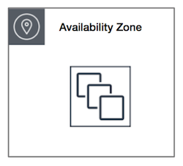
Clustered Placement Groups
Clustered placement groups is a grouping of instances within a single availability zone. Placement groups are recommended for applications that need low network latency, high network throughput or both.
Only certain instances can be launched into a clustered placement group.

Slide 6
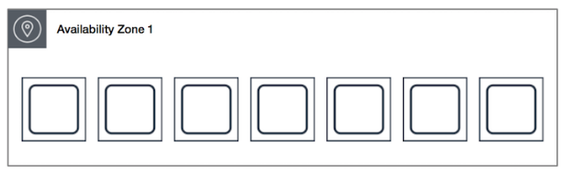
Spread Placement Group
A Spread placement group of instances that are each placed on distinct underlying hardware.
Spread placement groups are recommended for applications that have small number of critical instances that should be kept separate from each other.

Slide 7
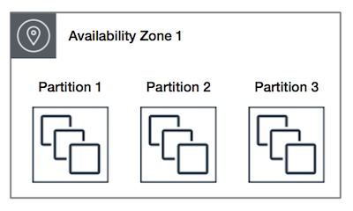
Partition Placement Groups
When using partition placement groups, Amazon EC2 divides each group into logical segments called partitions. Amazon Ec2 ensures that each partition within a placement group has its own set of racks. Each rack has its own network and power source.
No two partitions within the placement group shared the same racks, allowing you to isolate the impact of hardware failure within your application.

Slide 8
Exam Tips
Clustered placement groups
Low network latency/high network throughput
Spread placement groups
Individual Critical EC2 instances
Partition placement groups.
Multiple E2 instances HDFS, HBase and Cassandra

Slide 9
Exam Tips
Cluster placemen6t group can't span multiple Availability Zones.
Spread placement and partition placement group can
The name that you specify for a placement group must be unique within your AWS account
Only certain types of instances can be launched in placement groups. (Compute Optimize, GPU, Memory Optimized, Storage optimized)

Slide 10
Exam Tips
AWS recommend homogenous instances within clustered placement groups.
You can't merge placement groups
You can move an existing Ec2 instance into a placement group. Before you move the instance, the instance must be in the stopped state.
You can move or remove an instance using the AWS CLI or SDK, you can't do it via the console

Slide 11
Thank you

